Slide 1
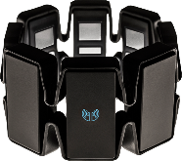


Android application
Web Server
Send
HTTP Request
Activity
Servlet
(Controller)
HTTP Request
Servlet
(Controller)
HTTP Response
Send
Call
Call
Call
Send
SessionBeanRemote
HTTP Response
HTTP Request
Call
JSP/HTML
(View)
HTTP Response
Web service
SessionBean
Call
Entity (JPA data access)
Association Call/Send
Query/update

